Slide 1





Add Company Name
Information available in audio.
AIRCRAFT CRASH ANALYSIS
PRESENTED BY
Shraddha Dwivedi

Slide 2
Problem Statement:
This internship project focuses on conducting a comprehensive analysis of airplane crashes and fatalities spanning from 1980 to 2023. The dataset contains crucial information such as crash dates, locations, operators, flight details, aircraft types, and fatality statistics. The goal is to leverage Power BI for interactive visualizations and in-depth insights to understand patterns, contributing factors, and trends in aviation incidents. The analysis aims to provide stakeholders with valuable information for enhancing aviation safety and mitigating risks.

Slide 3
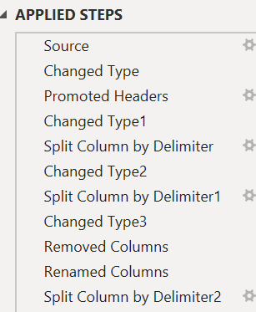
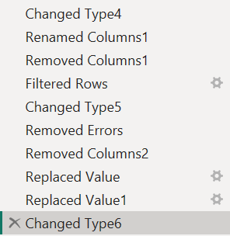
Transformation of Dataset

Slide 4
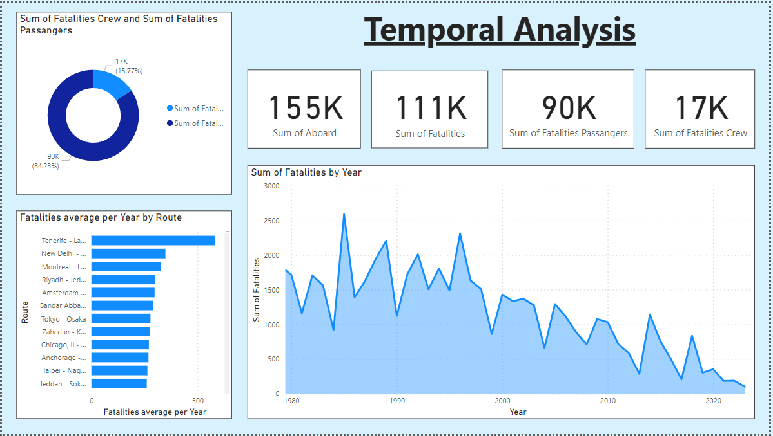

Slide 5
Temporal analysis revealed fluctuations in the frequency of airplane crashes over the years, with notable spikes and declines observed. Further investigation into these trends identified potential factors contributing to variations in crash frequency, offering insights for proactive safety measures. Additionally, the sum of fatalities by category, including accidents, other incidents, attacks, weather-related events, faulty design, and engine failure, was analyzed to understand the distribution of fatalities across different incident types over time.
Examining incident severity highlighted variations in the distribution of minor, serious, and fatal incidents over time. Interactive visualizations facilitated exploration of passenger and crew fatality trends, revealing patterns and correlations with factors such as aircraft type, operator, and geographical region. Furthermore, the analysis included the percentage of crew (16%) and passenger (84%) fatalities, providing a deeper understanding of the distribution of fatalities within the aircraft.
In-depth analysis identified factors contributing to passenger and crew fatalities in airplane crashes. By
integrating various data sources and leveraging advanced analytical techniques, the study elucidated
relationships between variables such as aircraft type, various Operators and fatality rates. Insights gained
from this analysis can inform targeted interventions aimed at reducing fatalities and enhancing aviation safety.

Slide 6
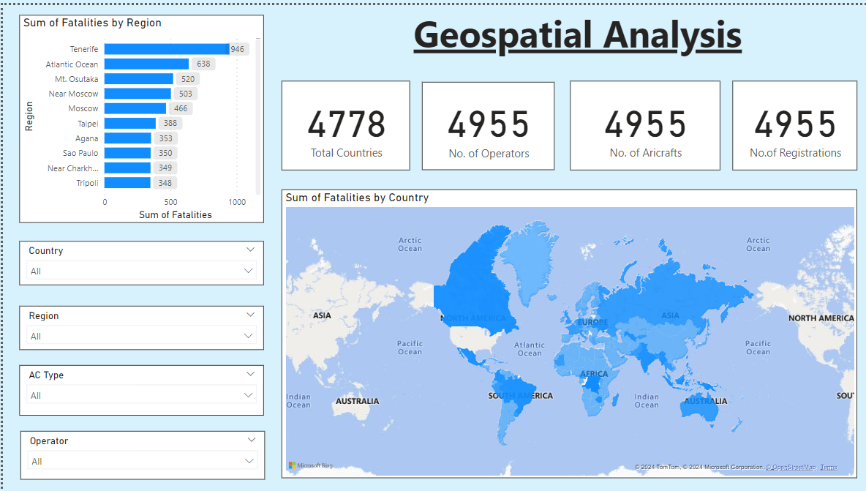

Slide 7
By visualizing crash locations on a world map, hotspots of incidents were identified, enabling stakeholders to focus their attention on regions with higher incident rates. Additionally, the distribution of incidents across different regions, including North America, Europe, and other regions, was analyzed to prioritize safety measures and allocate resources effectively.
Analyzing incident patterns along specific flight routes revealed insights into routes with a higher likelihood of incidents. By calculating incident rates for each route and identifying factors contributing to incident occurrences, stakeholders can make informed decisions regarding route planning, operational procedures, and safety protocols to mitigate risks and enhance aviation safety standards.
The involvement of specific aircraft types in incidents was thoroughly examined to understand their frequency and severity. By identifying aircraft types with higher incident rates and analyzing the relationship between aircraft registration and crash occurrences, stakeholders can implement targeted maintenance schedules, fleet management strategies, and safety regulations to address potential risks and improve overall safety performance.

Slide 8
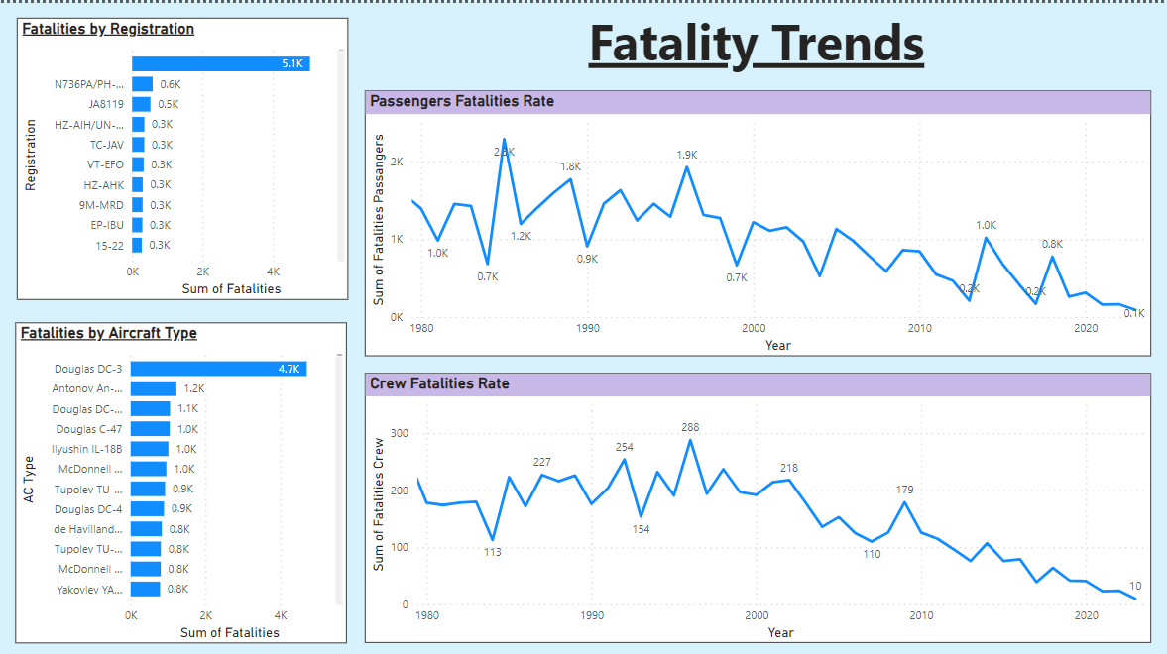

Slide 9
Exploring the trends in passenger and crew fatalities revealed fluctuations over the years, reflecting the dynamic nature of aviation safety. Through interactive visualizations, stakeholders gained a deeper understanding of how fatalities have evolved over time. This analysis provided valuable insights into the effectiveness of safety measures and the impact of regulatory changes on reducing fatalities in airplane incidents.
An investigation into the factors contributing to fatalities unveiled essential insights for enhancing aviation safety measures. By analyzing various variables such as aircraft type, operator, weather conditions, and incident severity, stakeholders gained valuable insights into the root causes of fatalities in airplane incidents.
This analysis facilitated the identification of risk factors and informed targeted interventions aimed at mitigating risks and improving safety standards.

Slide 10
Conclusion
Temporal Trends: Crash frequency fluctuates over time, with potential contributing factors identified for proactive safety measures. Fatality distribution across incident types (accidents, weather, etc.) is analyzed for deeper understanding.
Fatality Analysis: Passenger and crew fatality trends are explored, revealing correlations with aircraft type, operator, and region. In-depth analysis identifies factors contributing to fatalities, informing targeted interventions for reduced fatalities and improved safety.
Geospatial Analysis: Hotspots are identified by visualizing crash locations. Incident distribution across regions helps prioritize safety measures and resource allocation. Flight route analysis reveals high-risk routes.
Aircraft Analysis: Aircraft involvement is examined, focusing on types with higher incident rates and the link between registration and crashes. Targeted maintenance, fleet management, and safety regulations can be implemented to address potential risks.
Fatality Trends and Factors: Fluctuations in fatalities over time are explored, along with the impact of safety measures and regulations. Analysis of contributing factors like aircraft type, operator, and weather helps identify risk factors and inform safety improvements.

Slide 11
Thank You!

